Slide 1

Sohail Akhtar
CS Department
Bahria University, Islamabad Campus
Provided by:
Dr Muhammad Rashid Hussain

Slide 2


Agenda
HADOOP MAP REDUCE

Slide 3

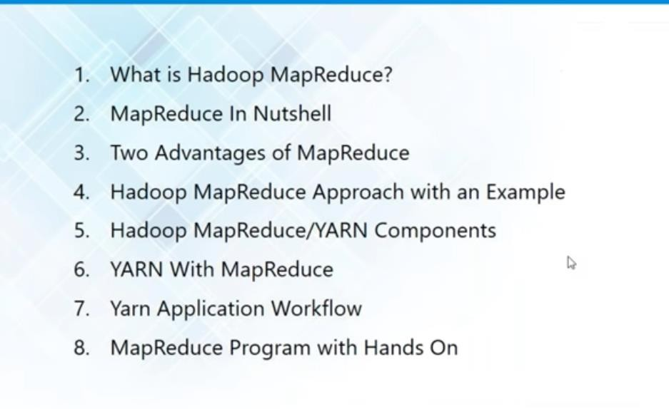
MAP REDUCE

Slide 4
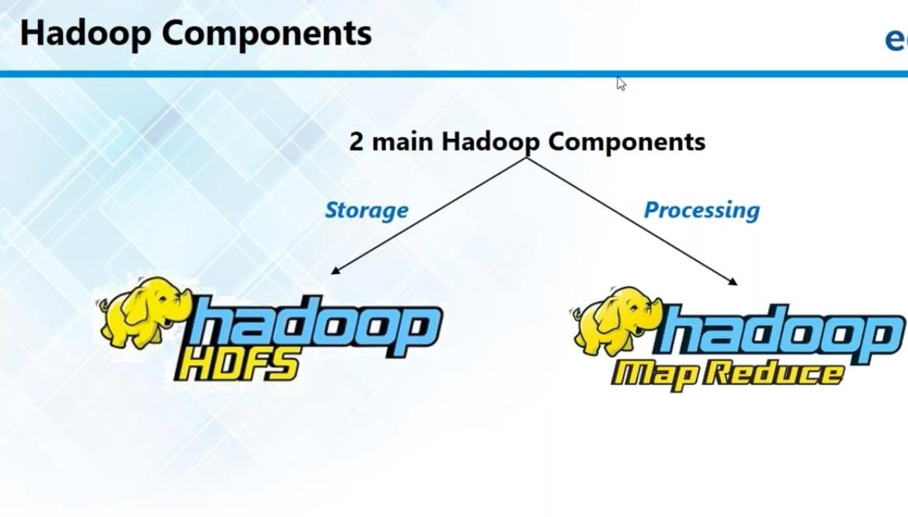
MAP REDUCE

Slide 5

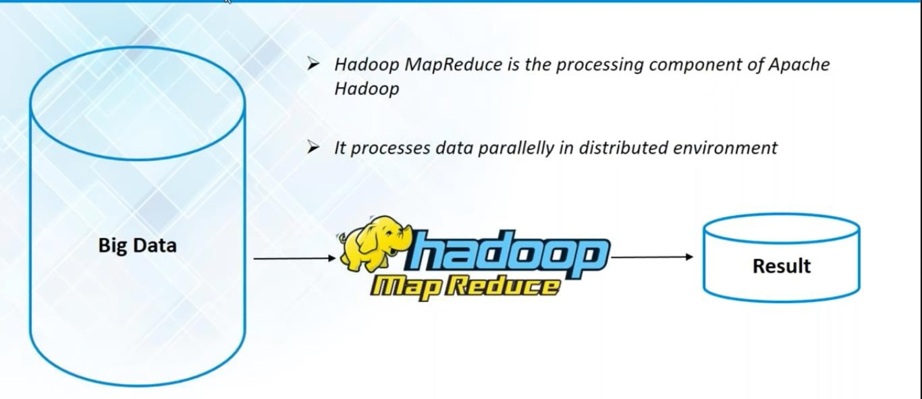
Map Reduce – Data Processing Unit

Slide 6

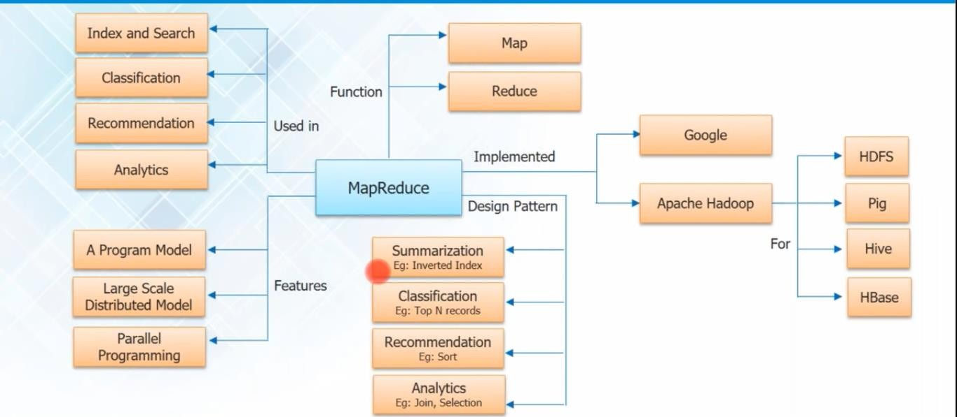
Map Reduce – Overview

Slide 7


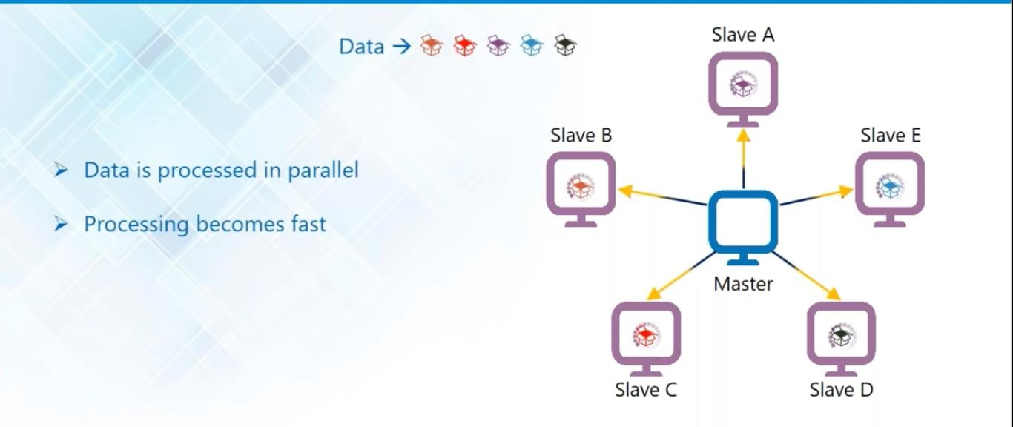
Map Reduce – High Level Advantages
Parallel Processing

Slide 8
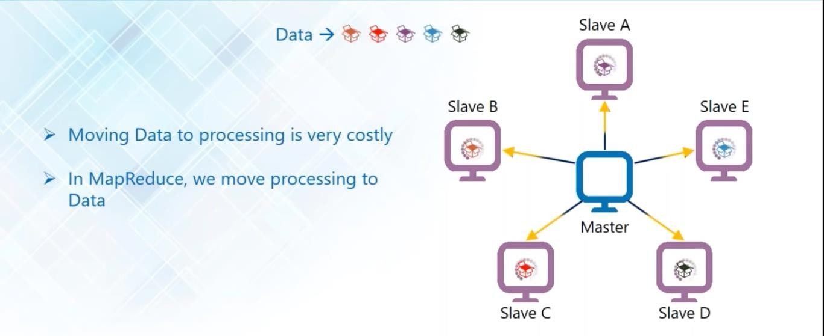
Map Reduce – High Level Advantages
Data Locality – Processing to Storage – Efficiency and bandwidth

Slide 9

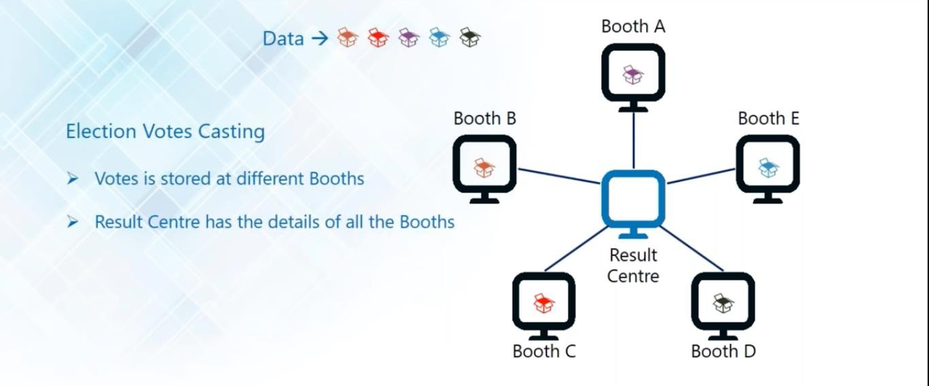
Traditional vs MapReduce
Election Votes Counting

Slide 10
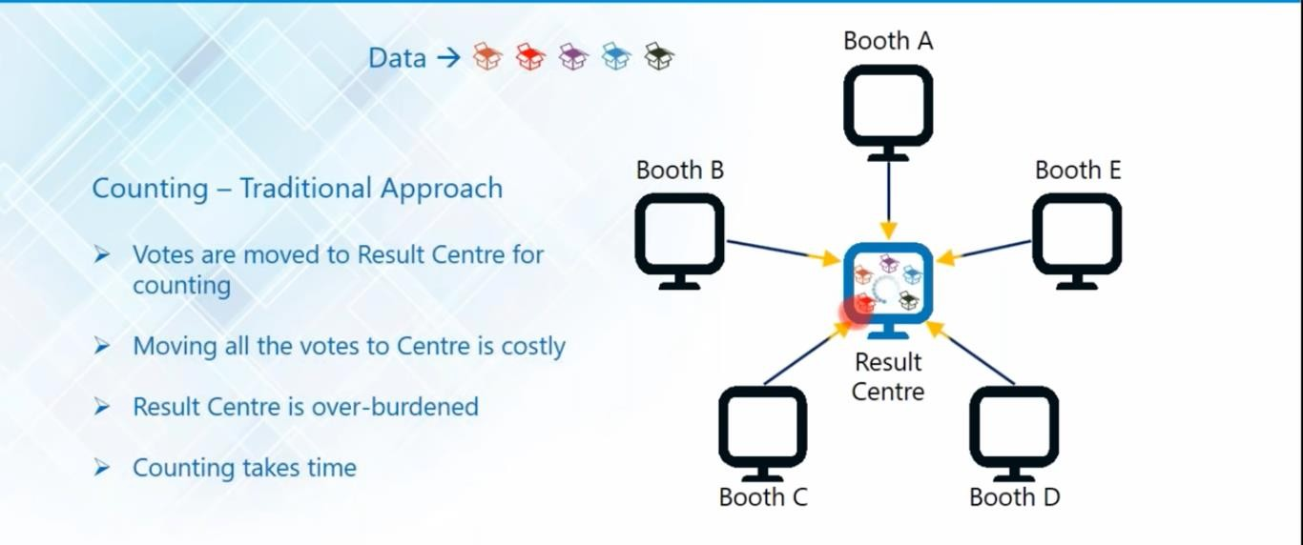
Traditional vs MapReduce
Traditional Way

Slide 11
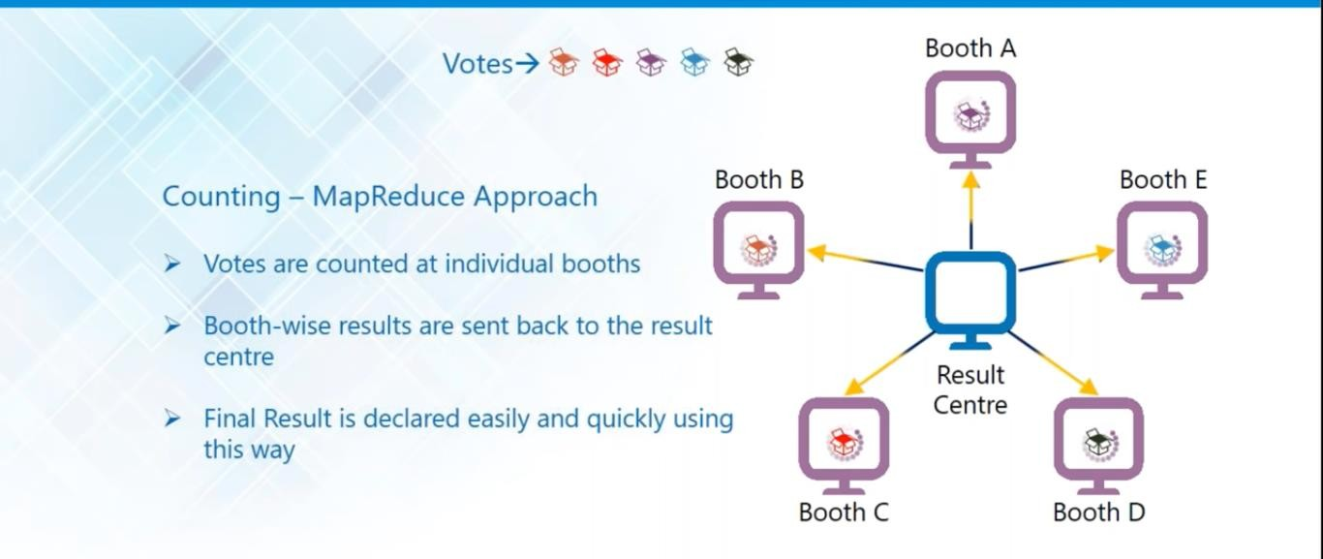
Traditional vs MapReduce
MapReduce Way

Slide 12


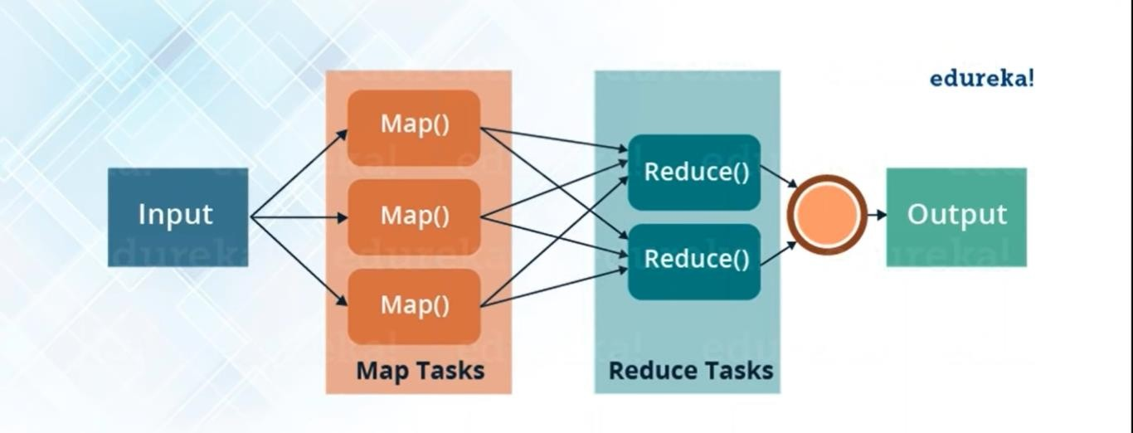
MapReduce – Detail Discussion
Individual Counting – Map Function Central Result – Reduce Function

Slide 13
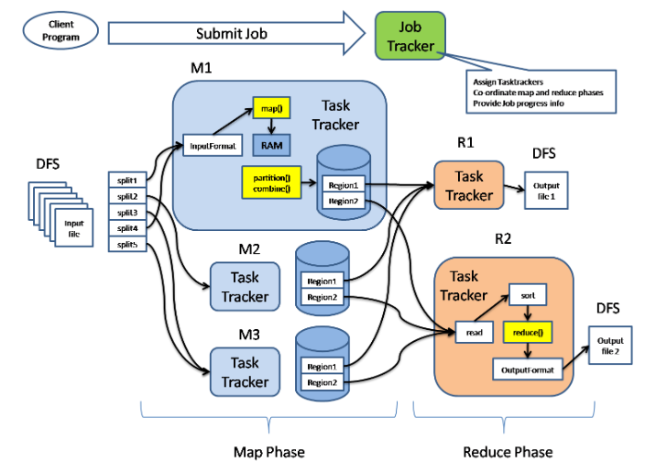
MapReduce – Detail Discussion
Hadoop 2.0 Daemons

Slide 14
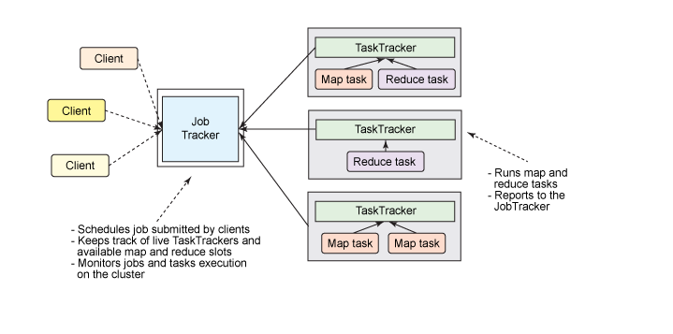
MapReduce – Detail Discussion
Hadoop 2.0 Daemons

Slide 15
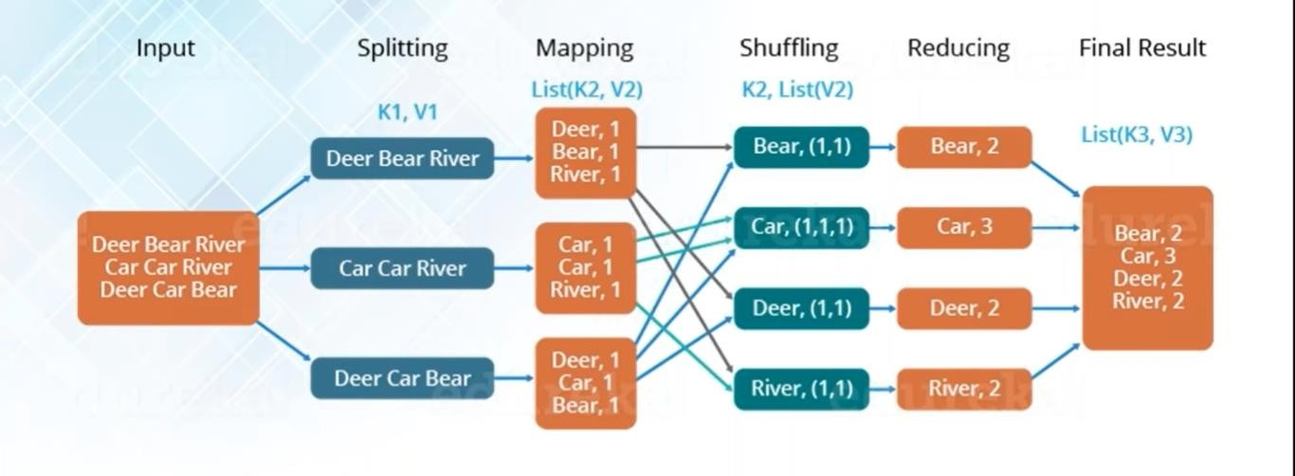
MapReduce – Detail Discussion
Overall Map reduce Word Count Process

Slide 16
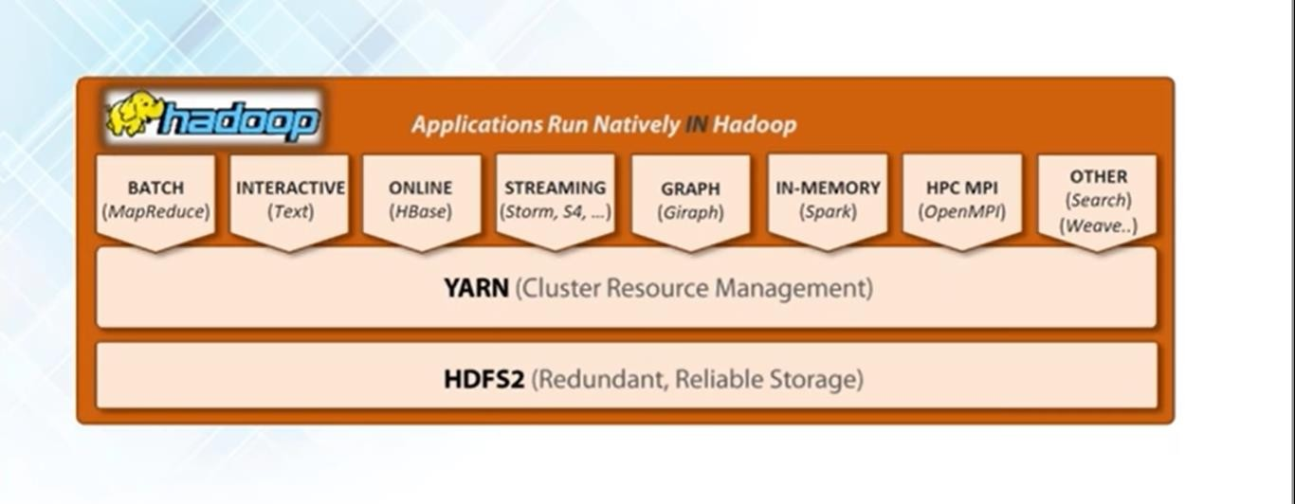
MapReduce – Detail Discussion
MapReduce using YARN

Slide 17
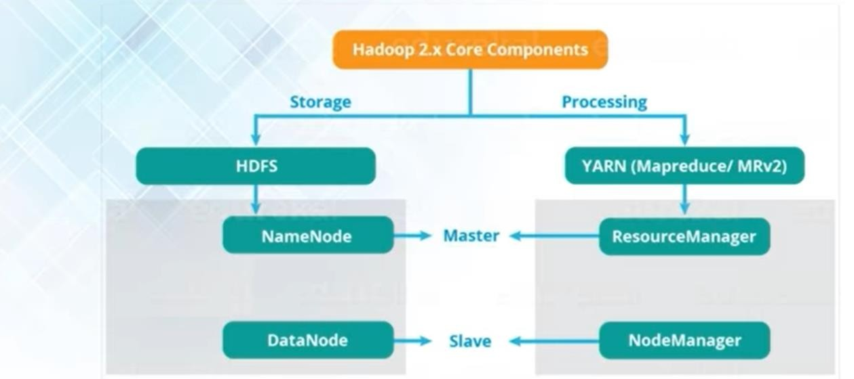
MapReduce – Detail Discussion
Hadoop 2.0 Daemons

Slide 18

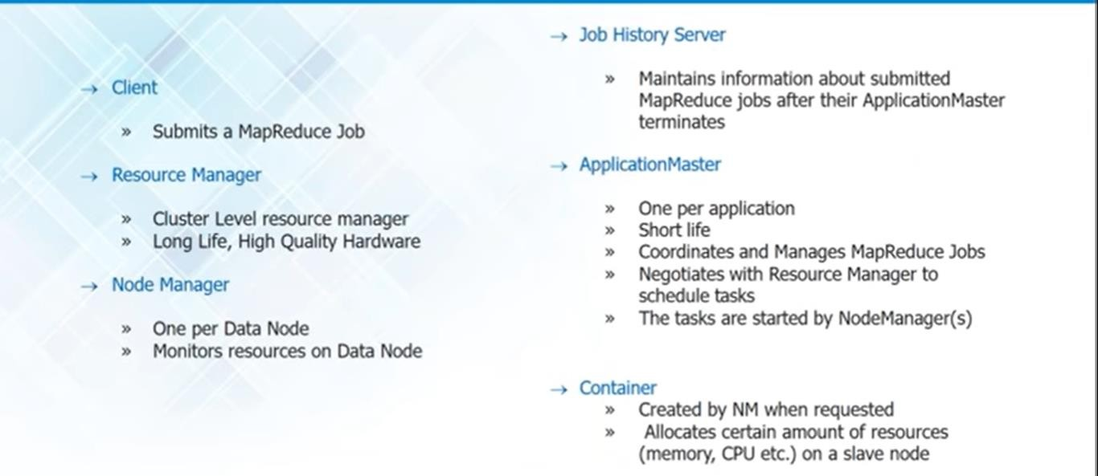
MapReduce – Detail Discussion
Hadoop 2.x MapReduce Yarn Components

Slide 19

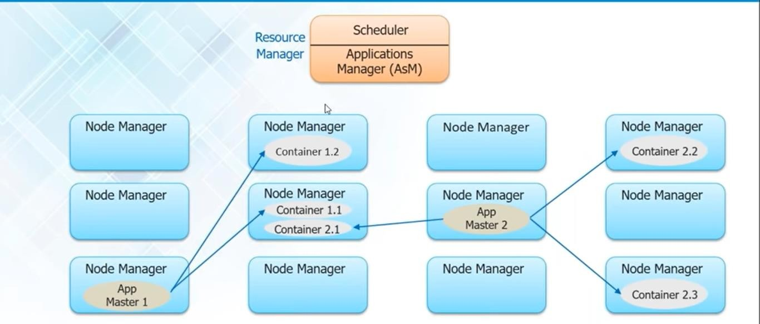
MapReduce – Detail Discussion
Yarn Workflow

Slide 20
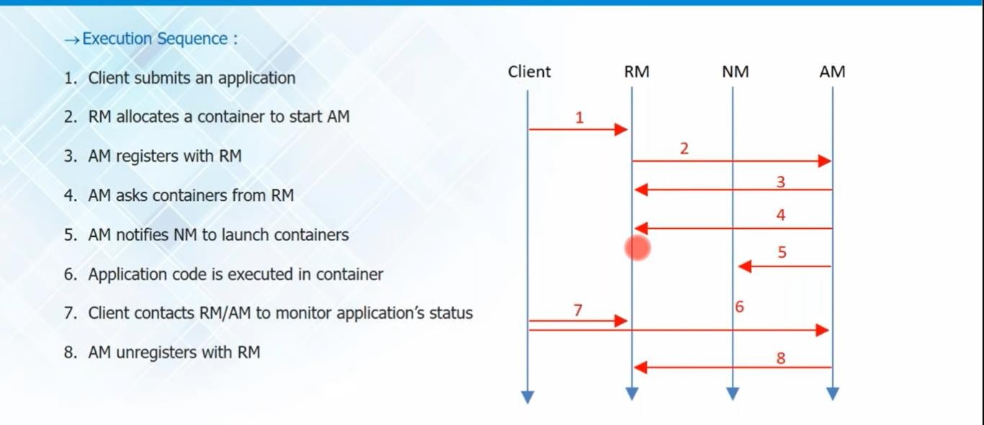
MapReduce – Detail Discussion
Application Workflow

Slide 21

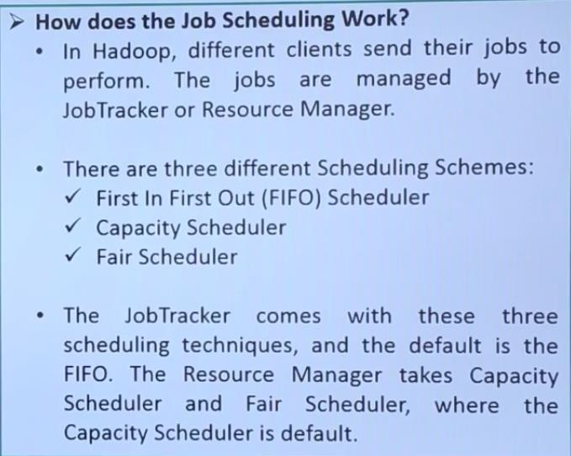
MAP REDUCE ( JOB SCHEDULING)

Slide 22

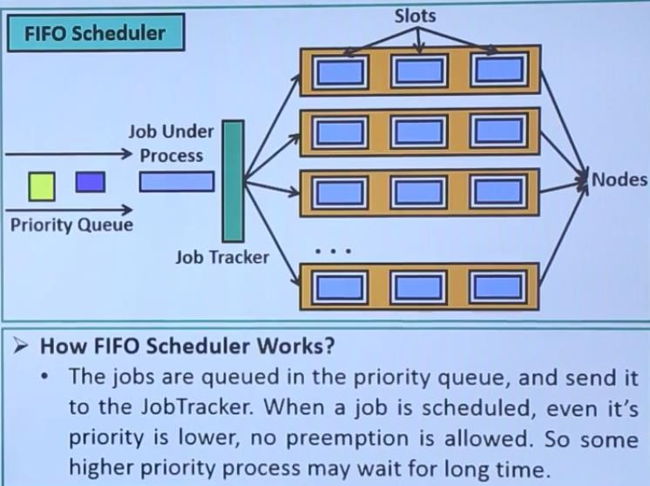
MAP REDUCE ( JOB SCHEDULING)

Slide 23

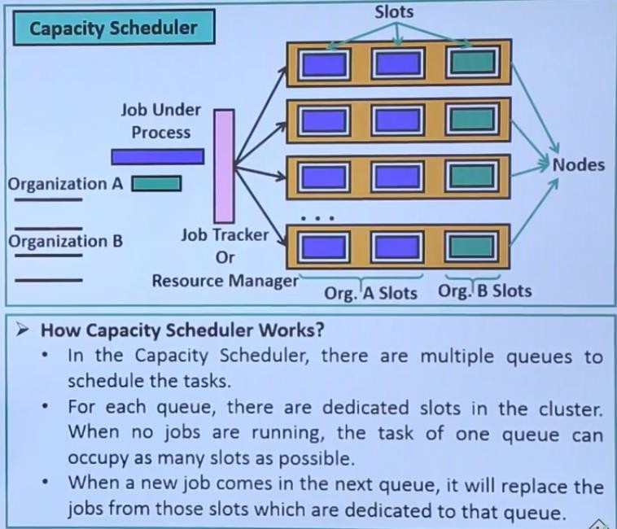
MAP REDUCE ( JOB SCHEDULING)

Slide 24

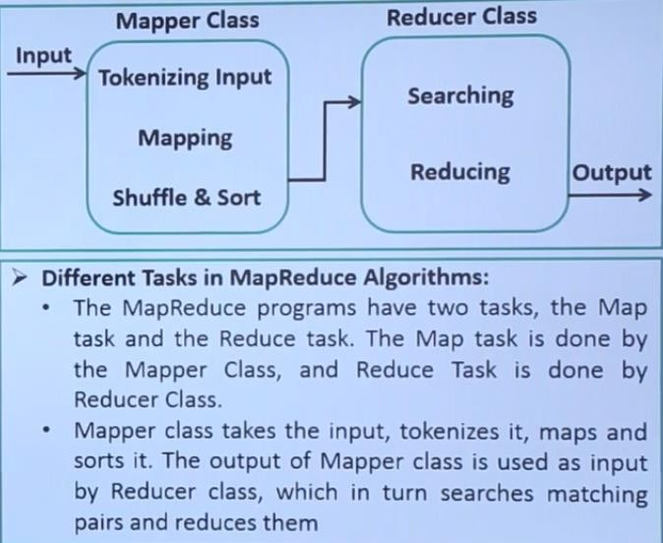
MAP REDUCE (BASICS OF ALGORITHM)

Slide 25

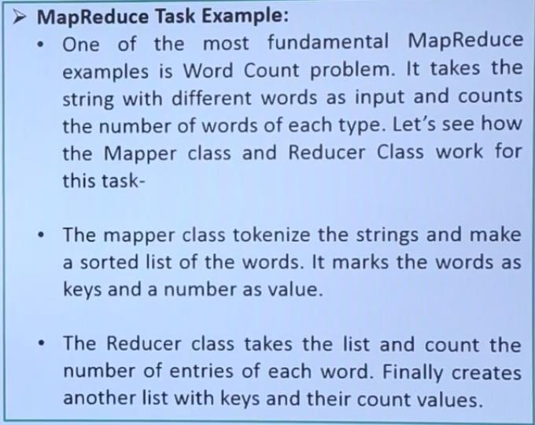
MAP REDUCE (BASICS OF ALGORITHM)

Slide 26
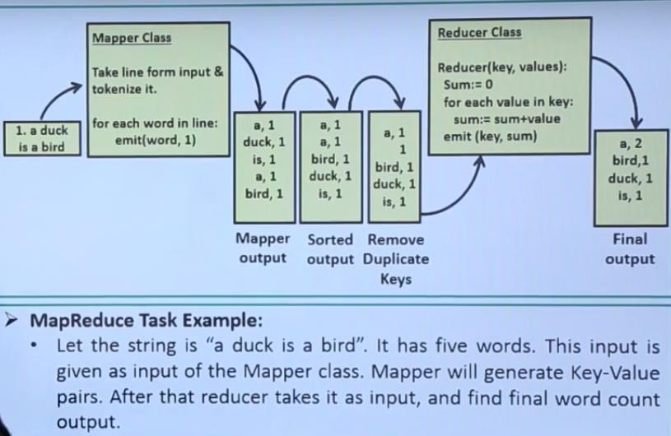
MAP REDUCE (BASICS OF ALGORITHM)

Slide 27
THANK YOU
27

